Slide 1
Introduction to Energy and Climate Modeling
Görkem Güngör
E-mail: ggungor@enerji.gov.tr

Slide 2
Model Structure
INPUT
Energy System Structure
MESSAGE
Model for Energy Supply System Alternatives and their General Environmental Impacts
OUTPUT
Primary and final energy mix
Emissions and waste streams
Environmental impacts
Resource use
Land use
Import dependence
Investment requirements
Base year energy flows and prices
Energy demand projections
Technology and Resource Options
Technical and policy constraints

Slide 3
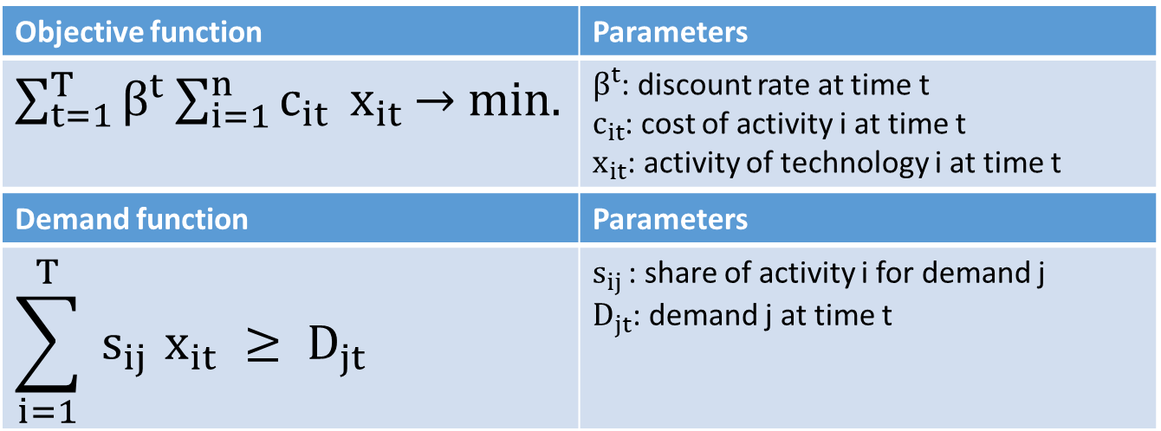
Some Mathematics

Slide 4
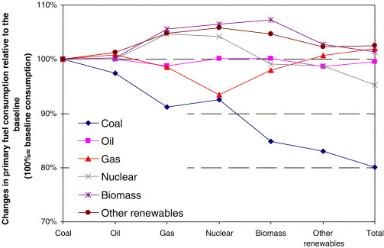
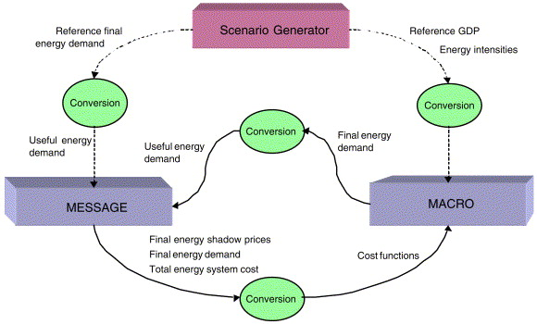
Socioeconomic Variables
Energy and climate policies have an impact on the GDP which should be mitigated
Iterative usage of energy and economic models calculates the demand quantities with respect to their costs/values
Energy model is constrained by capital (infrastructure) and environmental impacts
Economic model is constrained by capital (prices) and labor (wages)
Notes:
Klaassen, G., & Riahi, K. (2007). Internalizing externalities of electricity generation: An analysis with MESSAGE-MACRO. Energy Policy, 35(2), 815–827. https://doi.org/https://doi.org/10.1016/j.enpol.2006.03.007

Slide 5
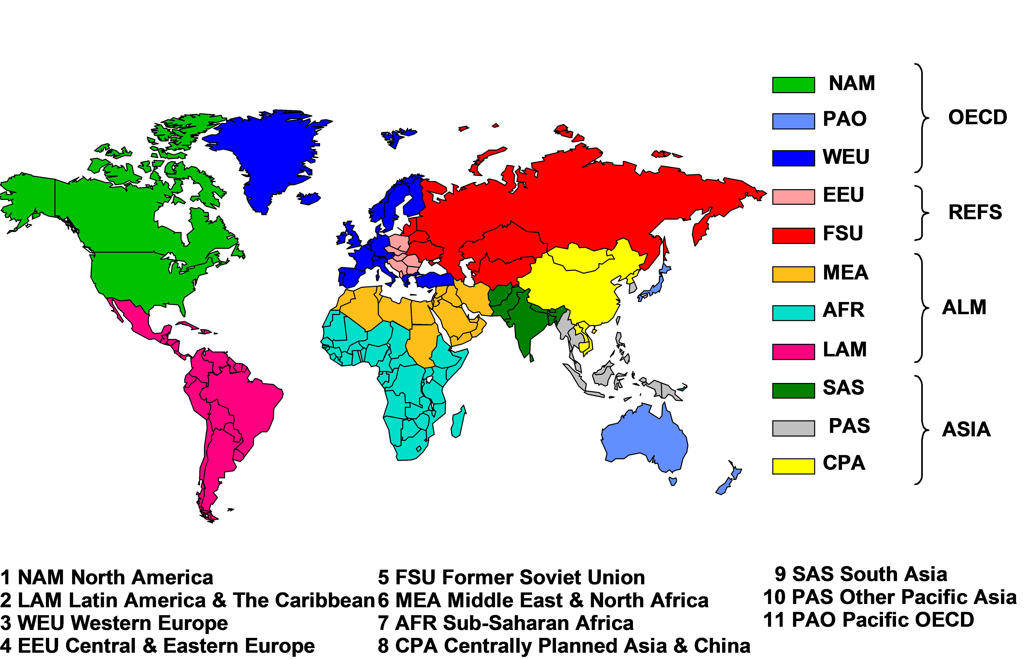
Spatial Coverage
Regional aggregation of countries with similar socioeconomic characteristics
+ A global trade region for market clearing of global energy markets
International aviation and shipping bunker fuel demand
Uranium resource extraction
Nuclear fuel cycle
Notes:
https://wiki.ucl.ac.uk/display/ADVIAM/Spatial+process+-+MESSAGE

Slide 6
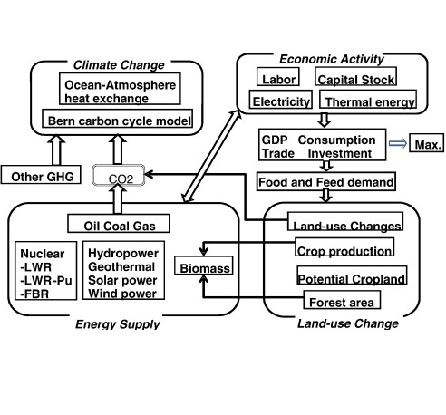
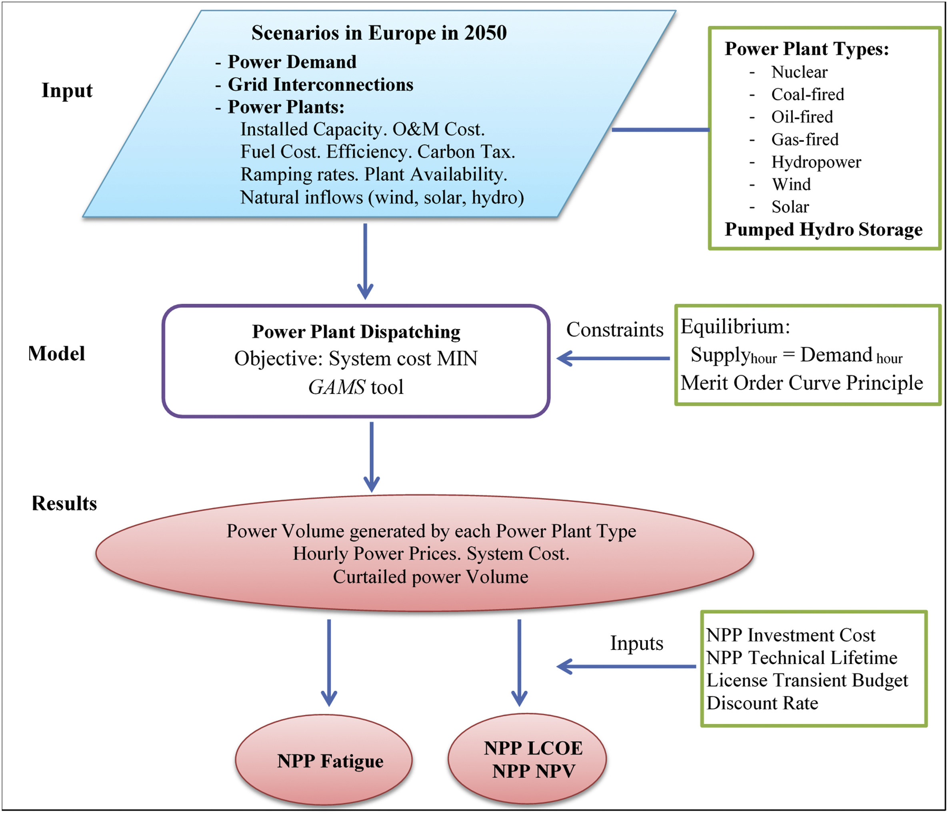
Energy System Dynamics
Energy models take yearly periods for energy balance
Energy usage depends on seasonal, daily and hourly human activities
Load-taking or load-shedding at system marginal price
Inter-regional energy import and export
Mitigation of trade-offs between economic growth and climate policies
Notes:
Loisel, R., Alexeeva, V., Zucker, A., & Shropshire, D. (2018). Load-following with nuclear power: Market effects and welfare implications. Progress in Nuclear Energy, 109, 280–292. https://doi.org/10.1016/j.pnucene.2018.08.011
Mori, S. (2012). An assessment of the potentials of nuclear power and carbon capture and storage in the long-term global warming mitigation options based on Asian Modeling Exercise scenarios. Energy Economics, 34(SUPPL. 3), S421–S428. https://doi.org/10.1016/j.eneco.2012.03.017

Slide 7
Simple Transport Model
Basic example derived from Dantzig (1963) example in GAMS Model Library
The objective is to minimize the total transport cost of cans from Seattle and San Diego to New York
The solution is trivial as the model will prefer transport from the shorter distance (Seattle) first as the transport cost is lower than the other route (San Diego)
Supply | Number of cans
Seattle | 300
San Diego | 400
Demand | Number of cans
New York | 600
Distance | 1000 miles
Seattle – New York | 2.5
San Diego – New York | 3.0
Transport cost | USD / 1000 miles
By freight | 90
Notes:
https://www.gams.com/mccarl/trnsport.gms

Slide 8
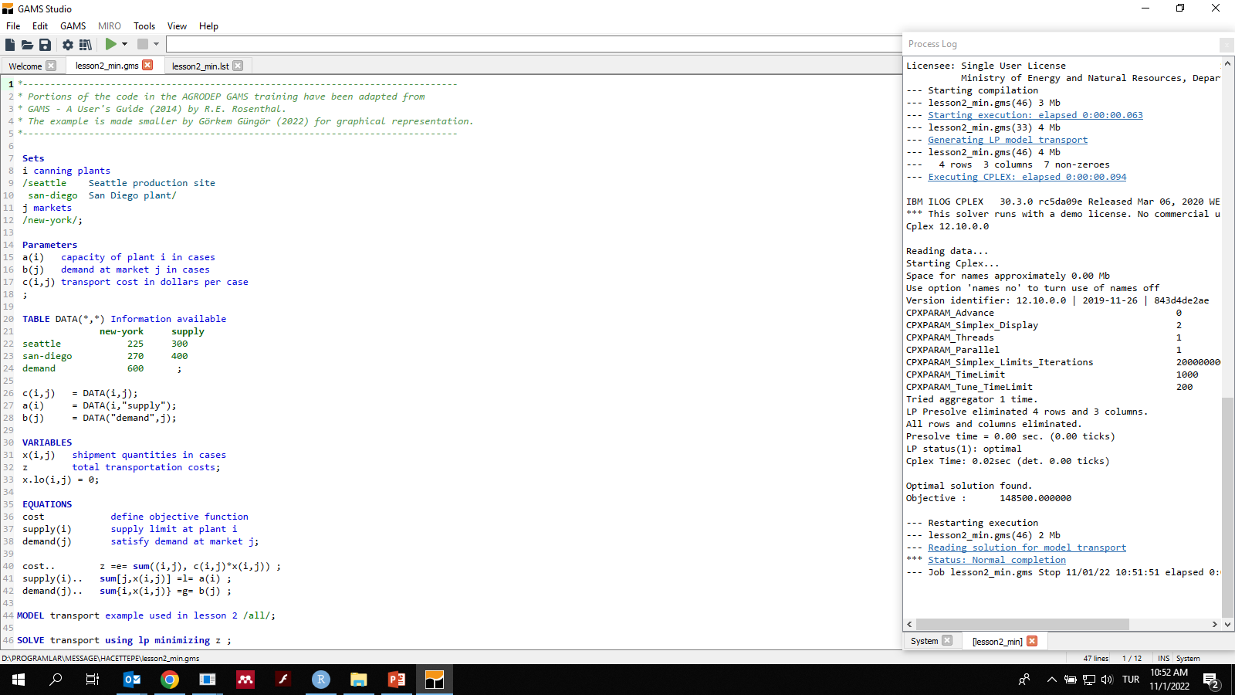
Model Intercomparison

Slide 9


Mathematical Solution
Primary solution
$$min.⟶z={\underline{c}}_{j}^{T}∗{\underline{x}}_{j}$$
$$s.t.⟶{\underline{\underline{A}}}_{ij}∗{\underline{x}}_{j}≥{\underline{b}}_{i}$$
$$x_{j}≥0 ∀j$$
Secondary solution
$$max.⟶w={\underline{b}}_{i}^{T}∗{\underline{u}}_{i}$$
$$s.t.⟶{\underline{u}}_{i}^{T}∗{\underline{\underline{A}}}_{ij}≤{\underline{c}}_{j}$$
$$u_{i}∈Q ∀i$$

Slide 10


Simple Transport Model
Primary solution
$$min.⟶z=225∗x_{seattle}+270∗x_{san−diego}$$
$$s.t.⟶x_{seattle}+x_{san−diego}≥600 (u1)$$
$$x_{seattle}≤300 (u2)$$
$$x_{san−diego}≤400 \left(u3\right)$$
$$x_{seattle}≥0 (u4)$$
$$x_{san−diego}≥0 (u5)$$
Secondary solution
$$max. ⟶w =600∗u1−300∗u2−400∗u3$$
$$s.t.⟶u_{1}−u_{2}+u_{4}≤225$$
$$u_{1}−u_{3}+u_{5}≤270$$

Slide 11
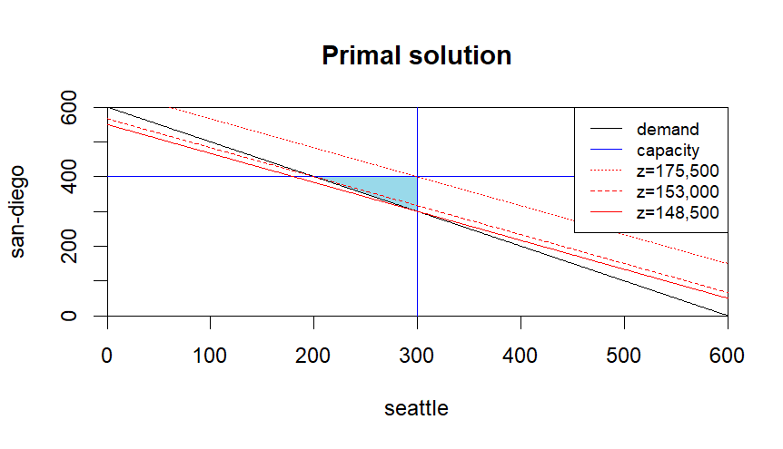
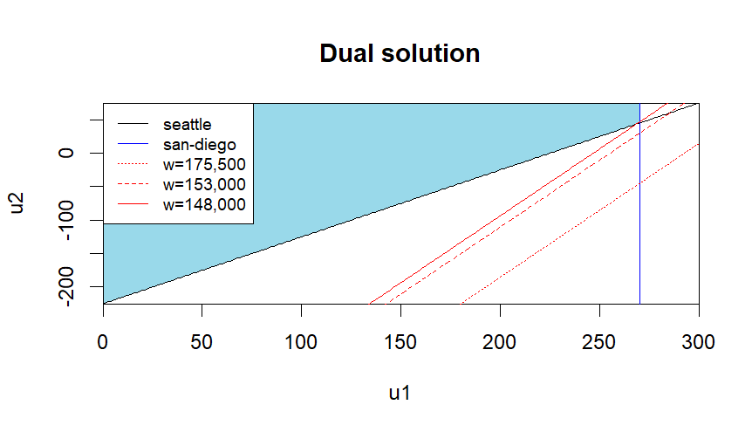
Simple Transport Model
Primal solution
Secondary solution (u3=u4=u5=0)

Slide 12


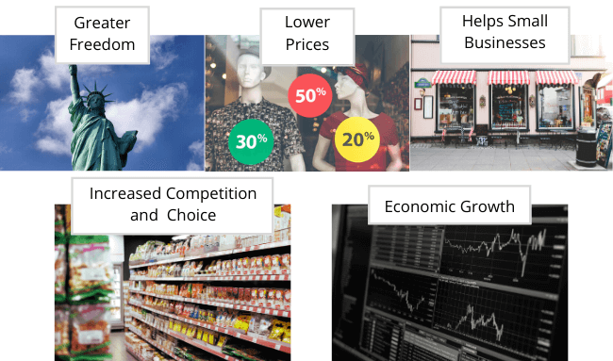
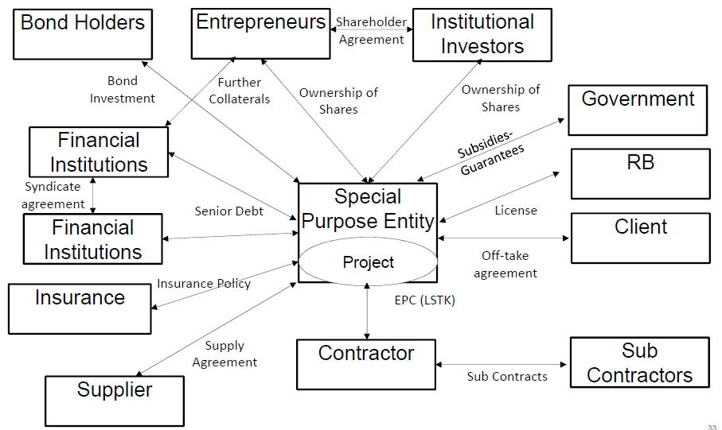
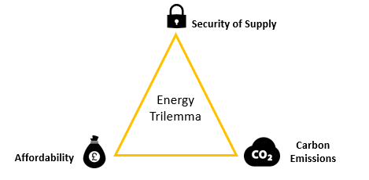
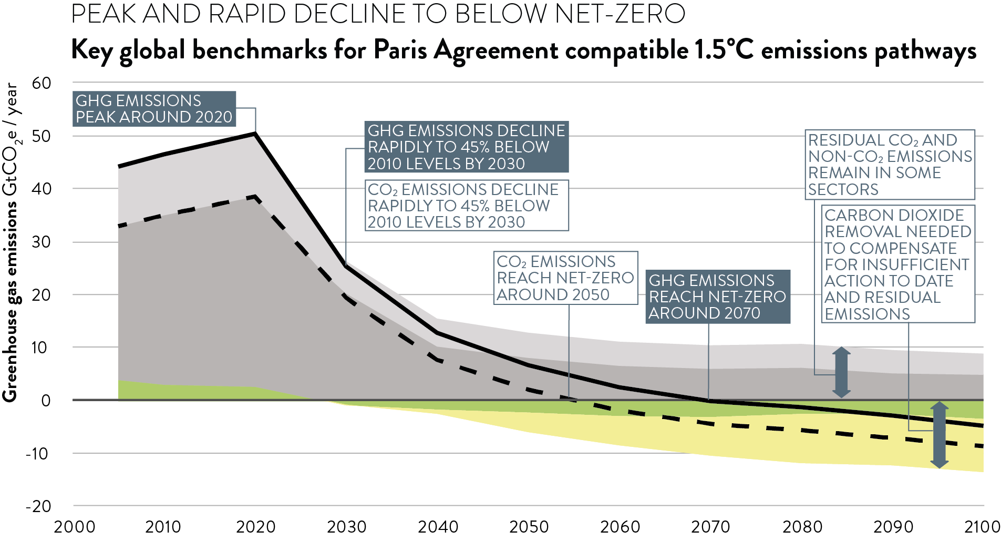
Energy System Modeling
Policy objectives:
Energy supply security
Climate change mitigation and adaptation
Market mechanisms
Investment financing
Sectoral subsidies (renewable energy, energy storage, e-fuels)
Foreign trade (EU Green Deal, China, USA)
Citizen engagement
Notes:
https://www.iaea.org/newscenter/news/iaea-continues-support-for-all-source-energy-planning-for-countries-despite-pandemic
http://www.esru.strath.ac.uk/EandE/Web_sites/17-18/windies/energy-trilemma.html
Dr Giorgio Locatelli PhD FHEA (2017). Organisational form supporting Climate Change Mitigation Strategies & plants. 1st Research Coordination Meeting on Assessments of the Potential Role of Nuclear Energy in National Climate Change Mitigation Strategies
https://climateanalytics.org/blog/2019/centred-on-science-how-the-ipcc-can-guide-mitigation-action/
https://boycewire.com/deregulation-definition-and-examples/
https://www.sciencedirect.com/science/article/abs/pii/S030142150400120X
https://ticaret.gov.tr/data/60f1200013b876eb28421b23/MUTABAKAT%20YE%C5%9E%C4%B0L.pdf
https://www.sciencedirect.com/science/article/pii/S030142152030598X

Slide 13
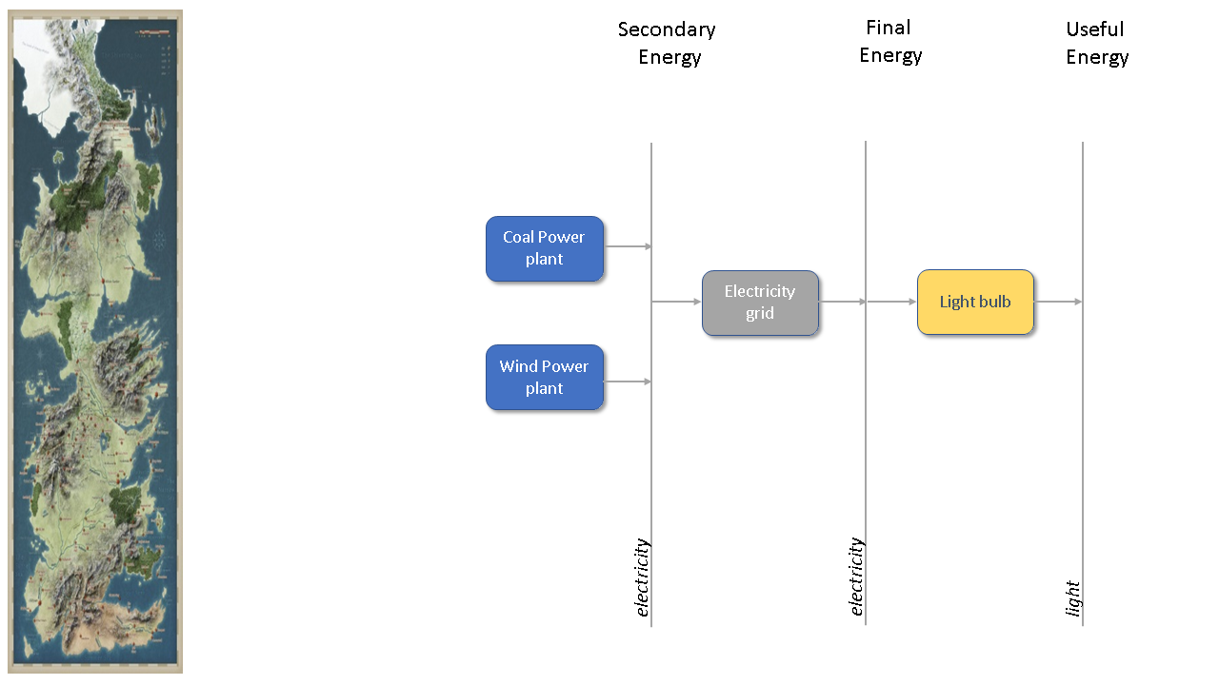
Baseline Energy System - Westeros
Notes:
This example is based on the Westeros Tutorial - Introduction to the MESSAGEix framework: Creating a baseline scenario.

Slide 14

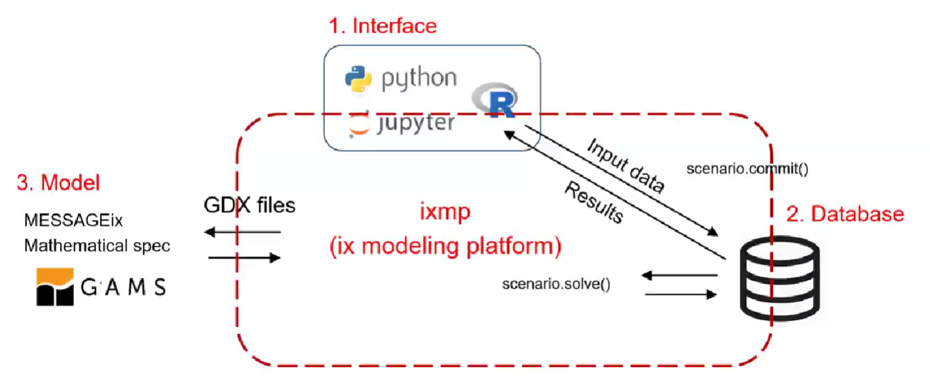
Model Structure
The model horizon spans three decades (690-720)
Far in the future after the events of A Song of Ice and Fire (which occur ~300 years after Aegon the conqueror)
The discount ratio is 5% per year
Notes:
https://awoiaf.westeros.org/index.php/Aegon%27s_Conquest

Slide 15
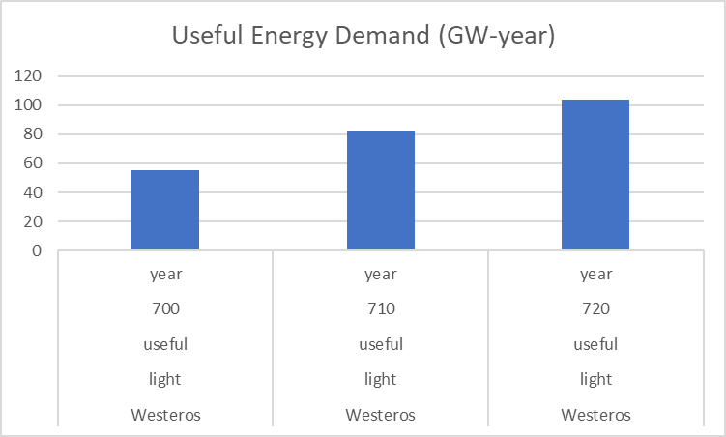
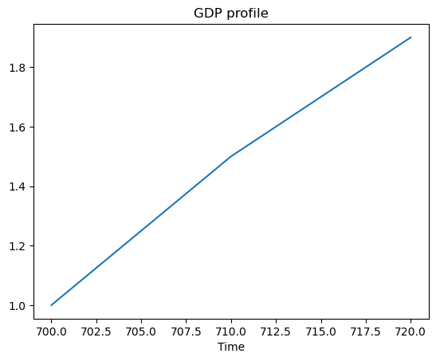
Energy Demand
Demand for electricity is correlated with production
GDP profile is similar to first world historical profiles in the beginning of the 20th century
Model assumptions:
40 million people in 300 AC
Similar population growth to Earth in the same time frame (~factor of 12)
A per capita demand for electricity of 1000 kWh

Slide 16
Technology Parameters
Activity costs | USD / kWyr
Electricity grid | 50
Coal power plant | 30
Technology | Main input | Main output | Efficiency
Light bulb | Elec./Final | Light/Useful | 1
Grid | Elec./Secon. | Elec./Final | 0.9
Coal_ppl |  | Elec./Secon
Wind_ppl |  | Elec./Secon
Investment costs | USD / kW
Light bulb | 5
Coal power plant | 500
Wind power plant | 1500
Historical capacity addition | MW/year
Light bulb | 12224 (690-699)
Coal power plant | 2685 (680-699)
Wind power plant | 4755 (680-699)
Fixed costs | USD / kW/yr
Coal power plant | 30
Wind power plant | 10
Operating lifetime | Years
Light bulb | 10
Coal power plant | 20
Wind power plant | 20
Capacity factor | Share
Wind power plant | 0.36

Slide 17

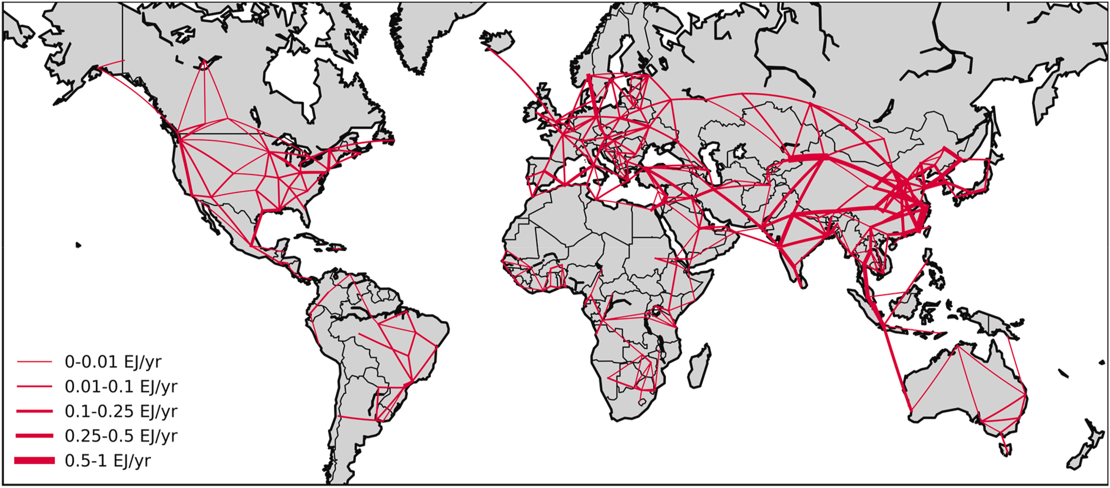
Modeling Bias
Capacity factor of wind power plant is taken as efficiency
Renewable energy generation is intermittent and predictable with scientific advancement
Renewable power is characteristically different than baseload generation
More realistic representation of spatial and temporal resolution
Curtailment requirements might favor renewable energy expansion
Notes:
Brinkerink, M., Zakeri, B., Huppmann, D., Glynn, J., Ó Gallachóir, B., & Deane, P. (2022). Assessing global climate change mitigation scenarios from a power system perspective using a novel multi-model framework. Environmental Modelling and Software, 150(January). https://doi.org/10.1016/j.envsoft.2022.105336
https://power.larc.nasa.gov/docs/

Slide 18
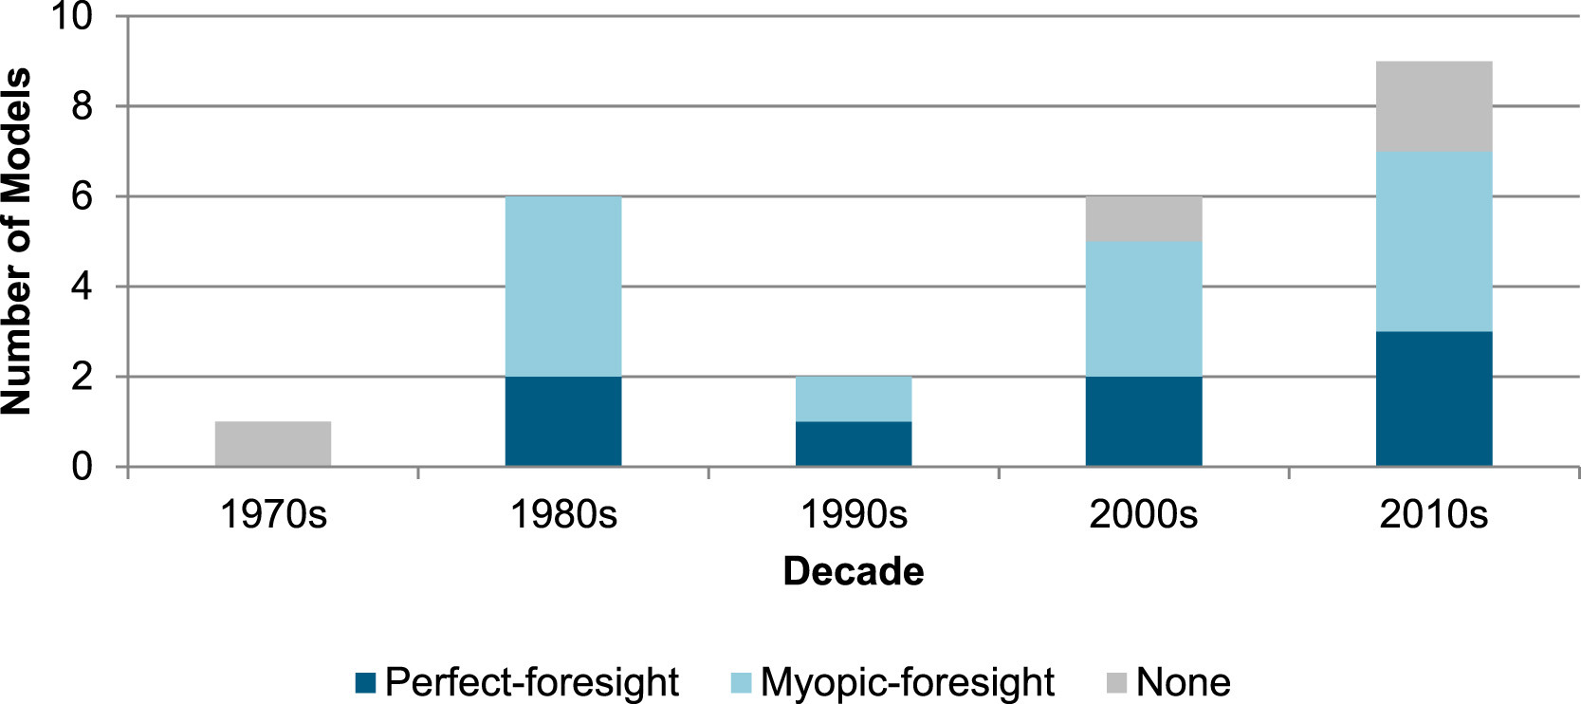
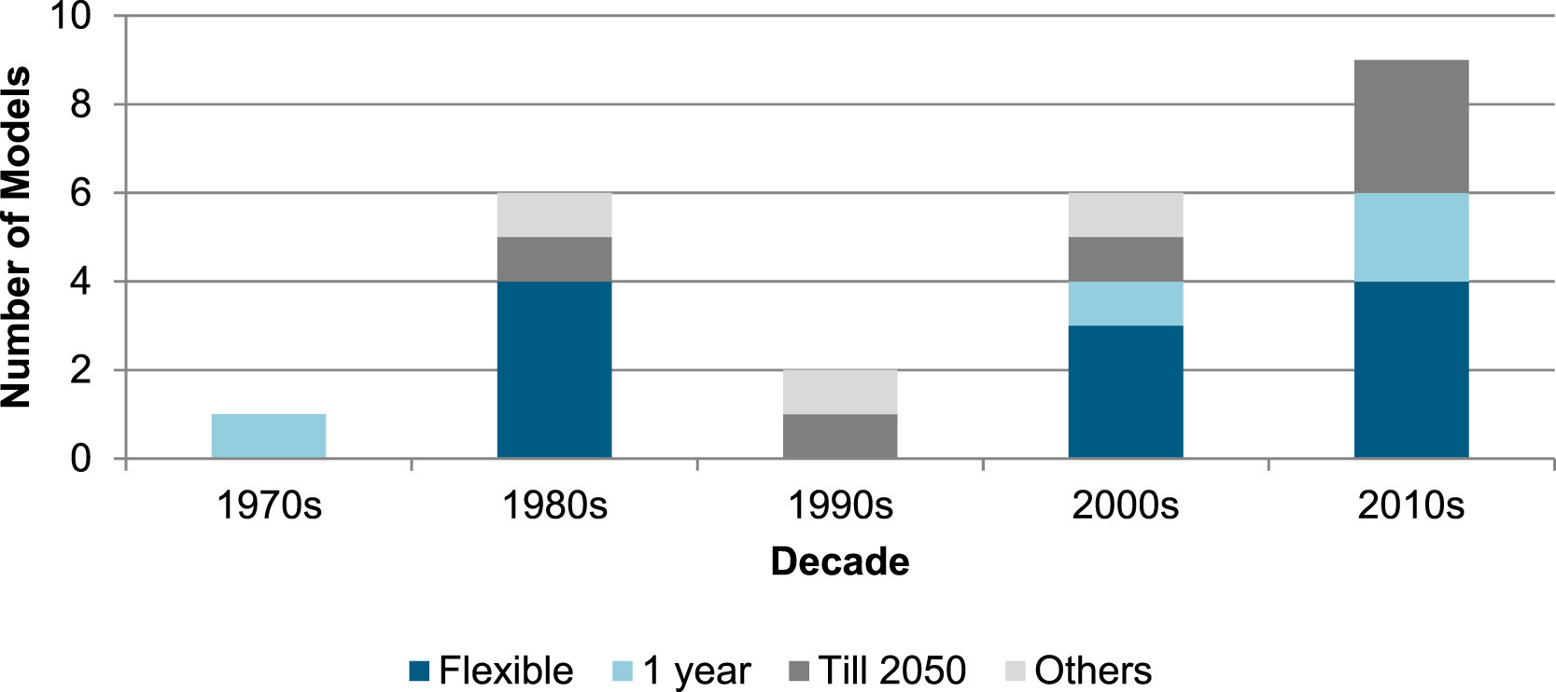
Time Horizon
The time horizons of energy system models can be fixed or flexible
2050 is one of the most important targets of the Paris Agreement
MESSAGE implements a perfect-foresight approach with decisions made considering the complete time horizon
Economic decisions are more short-sighted which can be modeled using a myopic-foresight approach
Notes:
Lopion, P., Markewitz, P., Robinius, M., & Stolten, D. (2018). A review of current challenges and trends in energy systems modeling. Renewable and Sustainable Energy Reviews, 96, 156–166. https://doi.org/10.1016/j.rser.2018.07.045

Slide 19
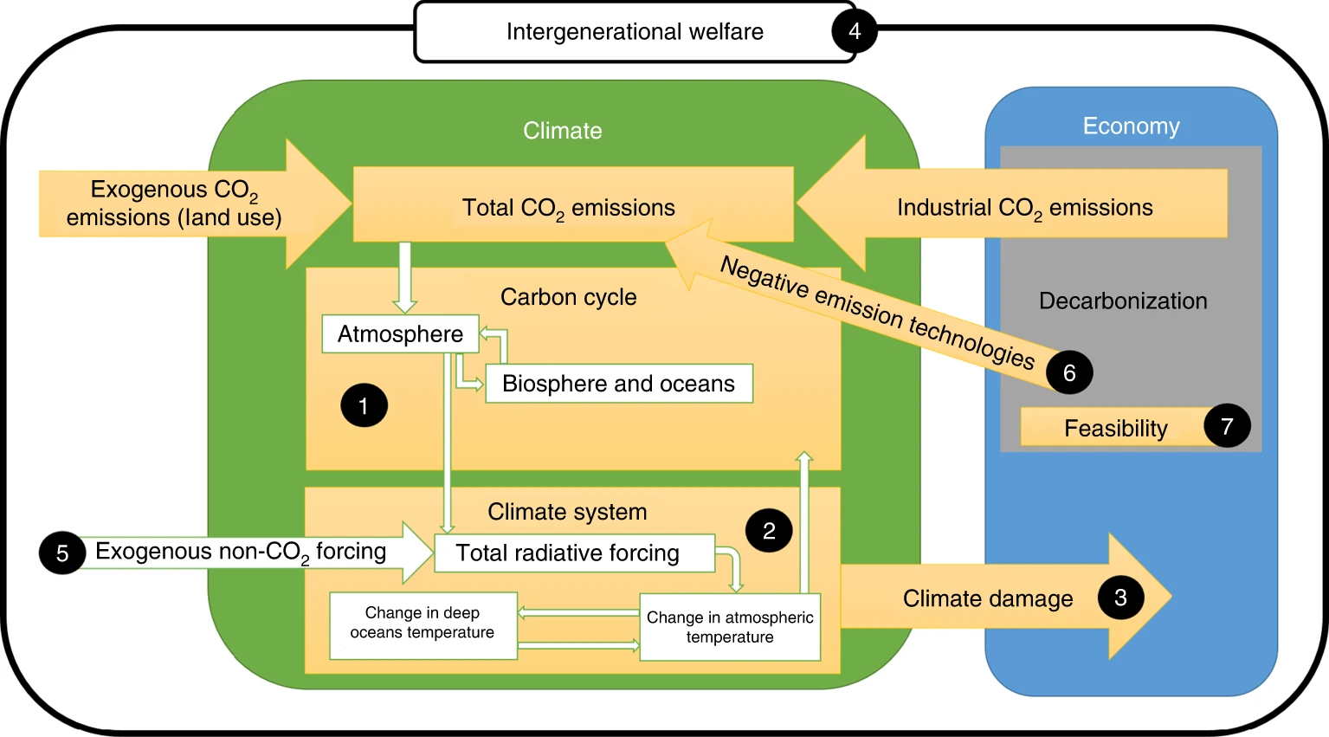
Discount Rate
Why should I take the burden of spending today when the productivity is low and the costs are high?
Why should the future generations take the burden of our costs when they can be better off without them?
Ethical conflicts arise in long-term problems, such as climate change, biodiversity loss and nuclear waste disposal
Notes:
Carson, R. T., & Tran, B. R. (2009). Discounting Behavior and Environmental Decisions. Journal of Neuroscience, Psychology, and Economics, 2(2), 112–130. https://doi.org/10.1037/a0017685
Hänsel, M. C., Drupp, M. A., Johansson, D. J. A. A., Nesje, F., Azar, C., Freeman, M. C., Groom, B., & Sterner, T. (2020). Climate economics support for the UN climate targets. Nature Climate Change, 10(8), 781–789. https://doi.org/10.1038/s41558-020-0833-x

Slide 20
References
[1] Klaassen G, Riahi K. Internalizing externalities of electricity generation: An analysis with MESSAGE-MACRO. Energy Policy [Internet]. 2007. 35(2):815–27.
[2] Loisel R, Alexeeva V, Zucker A, Shropshire D. Load-following with nuclear power: Market effects and welfare implications. Prog Nucl Energy [Internet]. 2018. 109:280–92.
[3] Mori S. An assessment of the potentials of nuclear power and carbon capture and storage in the long-term global warming mitigation options based on Asian Modeling Exercise scenarios. Energy Econ [Internet]. 2012. 34(SUPPL. 3):S421–8.
[4] Terzi A. Crafting an effective narrative on the green transition. Energy Policy [Internet]. 2020 Dec;147(August):111883.
[5] Brinkerink, M., Zakeri, B., Huppmann, D., Glynn, J., Ó Gallachóir, B., & Deane, P. (2022). Assessing global climate change mitigation scenarios from a power system perspective using a novel multi-model framework. Environmental Modelling and Software, 150(January).
[6] Lopion P, Markewitz P, Robinius M, Stolten D. A review of current challenges and trends in energy systems modeling. Renew Sustain Energy Rev [Internet]. 2018. 96:156–66.
[7] Carson RT, Tran BR. Discounting Behavior and Environmental Decisions. J Neurosci Psychol Econ. 2009. 2(2):112–30.
[8] Hänsel MC, Drupp MA, Johansson DJAA, Nesje F, Azar C, Freeman MC, et al. Climate economics support for the UN climate targets. Nat Clim Chang [Internet]. 2020. 10(8):781–9.

